Slide 1
Create an interactive timeline of AI history and its major milestones using Python libraries
An interactive timeline exploring the evolution of artificial intelligence.
Kaivalya Ajmire : AIDSU23041
Ganesh Padole: AIDSU23D071
Rohit Chavhan : AIDSU23055
Vedant Bole : AIDSU23064
Alok Bhos : AIDSU23029
Om Mangle : AIDS23047

Slide 2
Problem Statement
The goal of this project is to create an interactive timeline using Python libraries. Instead of focusing on AI milestones, the emphasis is on demonstrating how different Python libraries are utilized to implement an interactive and dynamic timeline. The challenge is to efficiently process data, visualize the timeline, animate elements for engagement, and seamlessly integrate the output into a PPT format.

Slide 3
Solution :
In this project, we utilize Python libraries to create an interactive timeline that visually represents the history of Artificial Intelligence (AI) and its major milestones. Python is widely used in data visualization and interactive applications, making it an ideal choice for this project.
By integrating powerful libraries like Matplotlib, Pandas, Numpy, IPython.display, and Textwrap, we can efficiently process data, plot events on a timeline, and animate the progression of AI milestones over time.

Slide 4
Major Milestones in AI History
1956 - The Birth of AI The Dartmouth Conference marked the beginning of AI.
1966 - ELIZA Joseph Weizenbaum developed ELIZA, one of the first NLP programs.
1980s - Expert Systems AI saw success with Expert Systems used in medical diagnosis and business.
1997 - Deep Blue IBM’s Deep Blue defeated Garry Kasparov in chess.
2011 - IBM Watson IBM Watson, an AI-powered system, won the quiz show Jeopardy!
2023 - Generative AI Boom AI models like ChatGPT and Stable Diffusion revolutionized industries with
powerful text and image generation capabilities, bringing AI to mainstream
applications.

Slide 5
Project Overview
This project aims to create an interactive timeline of AI history, focusing on how Python libraries are used to implement and display the timeline effectively. The goal is to demonstrate data visualization, animation, and automation
Key Features
Data Handling: Use pandas to structure AI milestone data.
Visualization: Use matplotlib to create a timeline representation.
Animation: Use matplotlib.animation.FuncAnimation for dynamic milestone appearance.
Interactivity: Use IPython.display.HTML to preview animations in Jupyter Notebook.

Slide 6
Technologies Used
1.Matplotlib: A Python library for creating static, animated, and interactive visualizations.
2.Pandas: A data analysis library that provides flexible data structures like Data Frames for handling structured Data .
3.NumPy: A library for numerical computing with support for large, multi-dimensional arrays and mathematical functions.

Slide 7
More technologies Used
4.Matplotlib Animation : It supports functions like (FuncAnimation) for creating smooth, frame-by-frame animations in Python.
5.Python display: It includes functions like display() and HTML() for embedding interactive content.
.
6.Textwrap: The textwrap module in Python is used for formatting and wrapping long text into multiple lines based on a specified width

Slide 8
Software used :
Google Colab : For writing python code
Visual Studio Code : For building website, using HTML

Slide 9
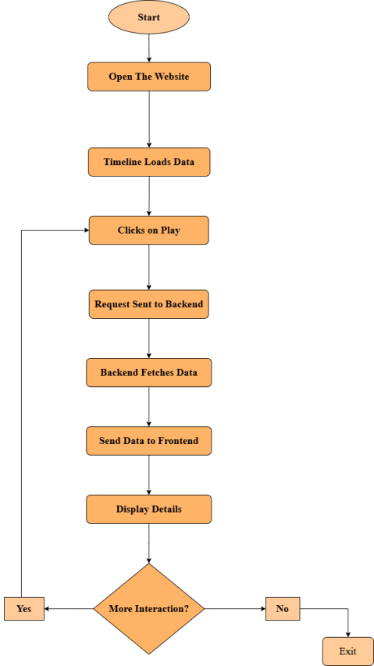
Flowchart
User Opens Website – The user accesses the introductory page
User Clicks on a ai time line – The frontend fetches AI milestone data from the backend.
Request Sent to Backend – JavaScript sends a request to the backend.
Backend Fetches Data – The backend retrieves the selected event’s details from the database.
Send Data to Frontend – The backend sends event details (text, images, year, etc.).
Display Details – The frontend updates the UI with event details.
User Interacts Further – The user can explore milestones by just clicking left and right to the sceen or exit the site.

Slide 10
System Architecture User
1. User Interaction:
Users click on AI Timeline Hub to explore AI milestones interactively. Events trigger dynamic content updates.
2. Frontend (HTML):
Uses of HTML to display an interactive timeline. Enhances user experience with animations and smooth transitions.
3. Backend (Python):
Handles user requests and fetches AI milestone data . Processes and serves structured data to the frontend.
4. Database (Python Data frame):
Stores AI milestones, including dates, descriptions, and relevant links. Enables efficient data retrieval and management

Slide 11
Conclusions
This project highlights the effective use of multiple Python libraries to create an AI timeline that visually represents key milestones. By integrating pandas for structured data handling, numpy for efficient computations, matplotlib for data visualization, we demonstrate how these tools work together to create a dynamic and engaging timeline.

Slide 12
Reference:
1. Brief history of past present futures of artificial intelligence
Link:- https://www.researchgate.net/publication/334539401_A_Brief_History_of_Artificial_Intelligence_On_the_Past_Present_and_Future_of_Artificial_Intelligence?
2. This review presents a detailed timeline of Al history, highlighting significant milestones from Aristotle to the present.
Link : https://www.researchgate.net/publication/385939923_Artificial_Intelligence_Through_Time_A_Comprehensive_Historical_Review/link/676fb15600aa3770e0c2516f/download?_tp=eyJjb250ZXh0Ijp7ImZpcnN0UGFnZSI6InB1YmxpY2F0aW9uIiwicGFnZSI6InB1YmxpY2F0aW9uIn19

Slide 13
Reference:
3. This foundational paper introduces Matplotlib as a 2D plotting library for Python, detailing its capabilities in visualizing scientific, engineering, and financial data.
Link : https://www.researchgate.net/publication/234238535_matplotlib__A_Portable_Python_Plotting_Package/link/0deec515b54c833908000000/download?_tp=eyJjb250ZXh0Ijp7ImZpcnN0UGFnZSI6InB1YmxpY2F0aW9uIiwicGFnZSI6InB1YmxpY2F0aW9uIn19

Slide 14
Thank You

